Slide 1
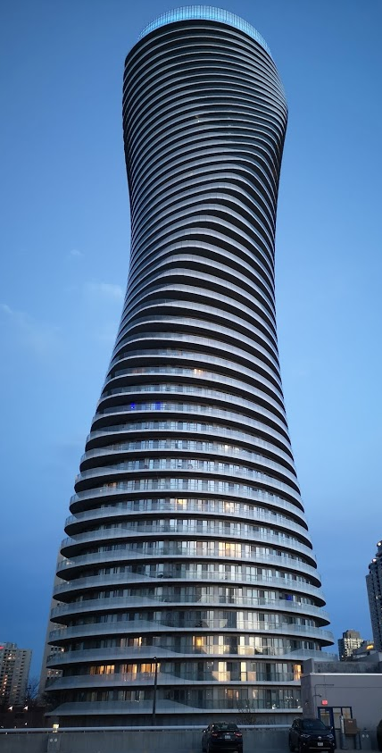
Teranet dataset
EDA results
Prepared by: Stepan Oskin
Notes:
Growth centers
West Don Lands
Liberty village
Riverdale
Outline
Deadline to submit thesis
Month-by-month tuition

Slide 2
Section 1:
Distributions

Slide 3
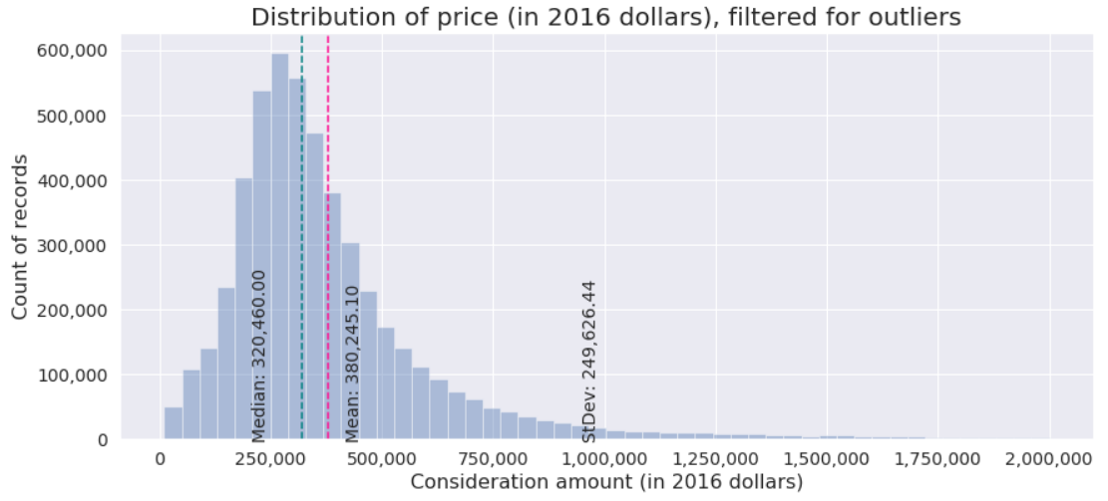
1.1: Distribution of price corrected to 2016

Slide 4
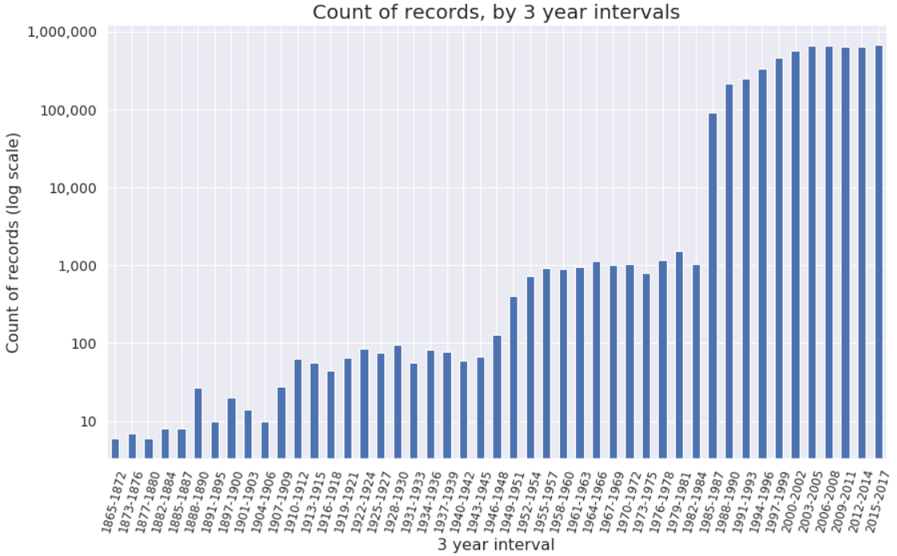
1.2: Distribution of count of records
Dramatic change in the count of records from 1984 to 1985

Slide 5
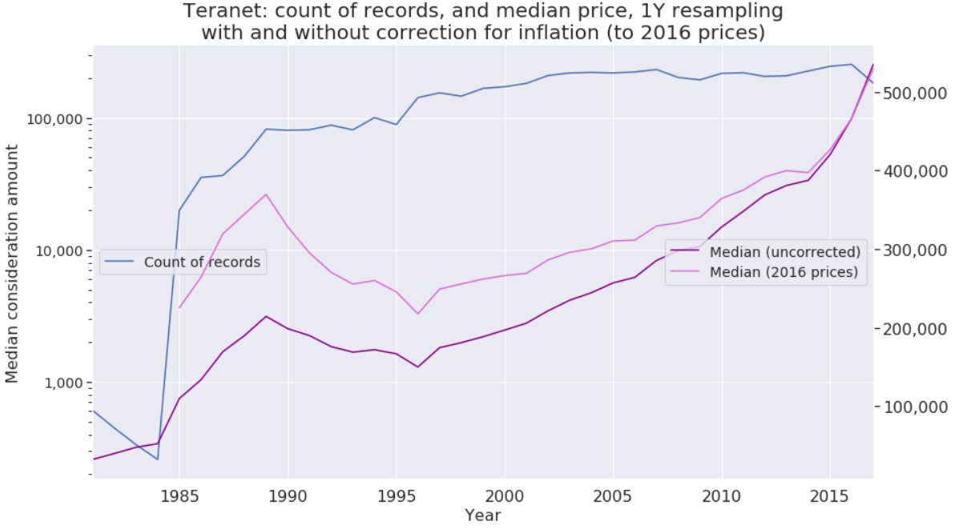
1.3: Median consideration amount
with and without correction for inflation (to 2016 prices)
YEAR | 1985 | 1986 | 1987 | 1988 | 1989 | 1990 | 1991 | 1992 | 1993 | 1994 | 1995 | 1996 | 1997 | 1998 | 1999 | 2000
Percentage change compared to 2016 prices (X) | 104.92 | 97.40 | 88.47 | 81.32 | 72.36 | 65.09 | 55.35 | 53.69 | 51.17 | 51.17 | 47.21 | 45.06 | 42.65 | 41.25 | 38.97 | 35.18
2001 | 2002 | 2003 | 2004 | 2005 | 2006 | 2007 | 2008 | 2009 | 2010 | 2011 | 2012 | 2013 | 2014 | 2015 | 2016 | 2017 | 2018 | 2019
30.80 | 29.23 | 25.95 | 22.84 | 20.77 | 17.90 | 15.37 | 11.87 | 12.16 | 11.10 | 7.76 | 6.17 | 4.96 | 2.54 | 1.49 | 0 | -1.00 | -3.37 | -5.28

Slide 6
Section 2:
Boxplots

Slide 7
Section 1.1:
Boxplots of price
by year

Slide 8
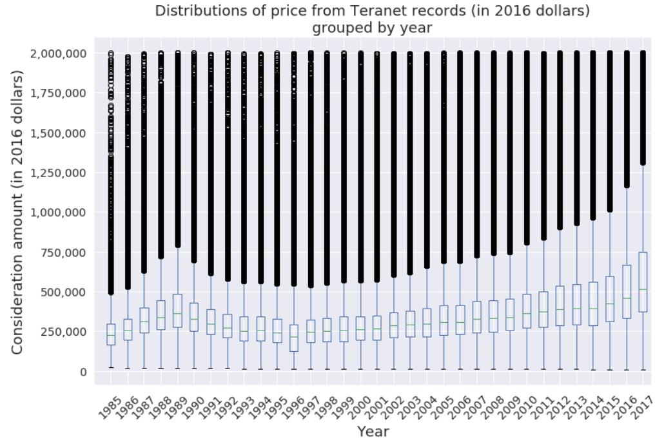

Slide 9
Section 1.2:
Boxplots of price
by municipality

Slide 10
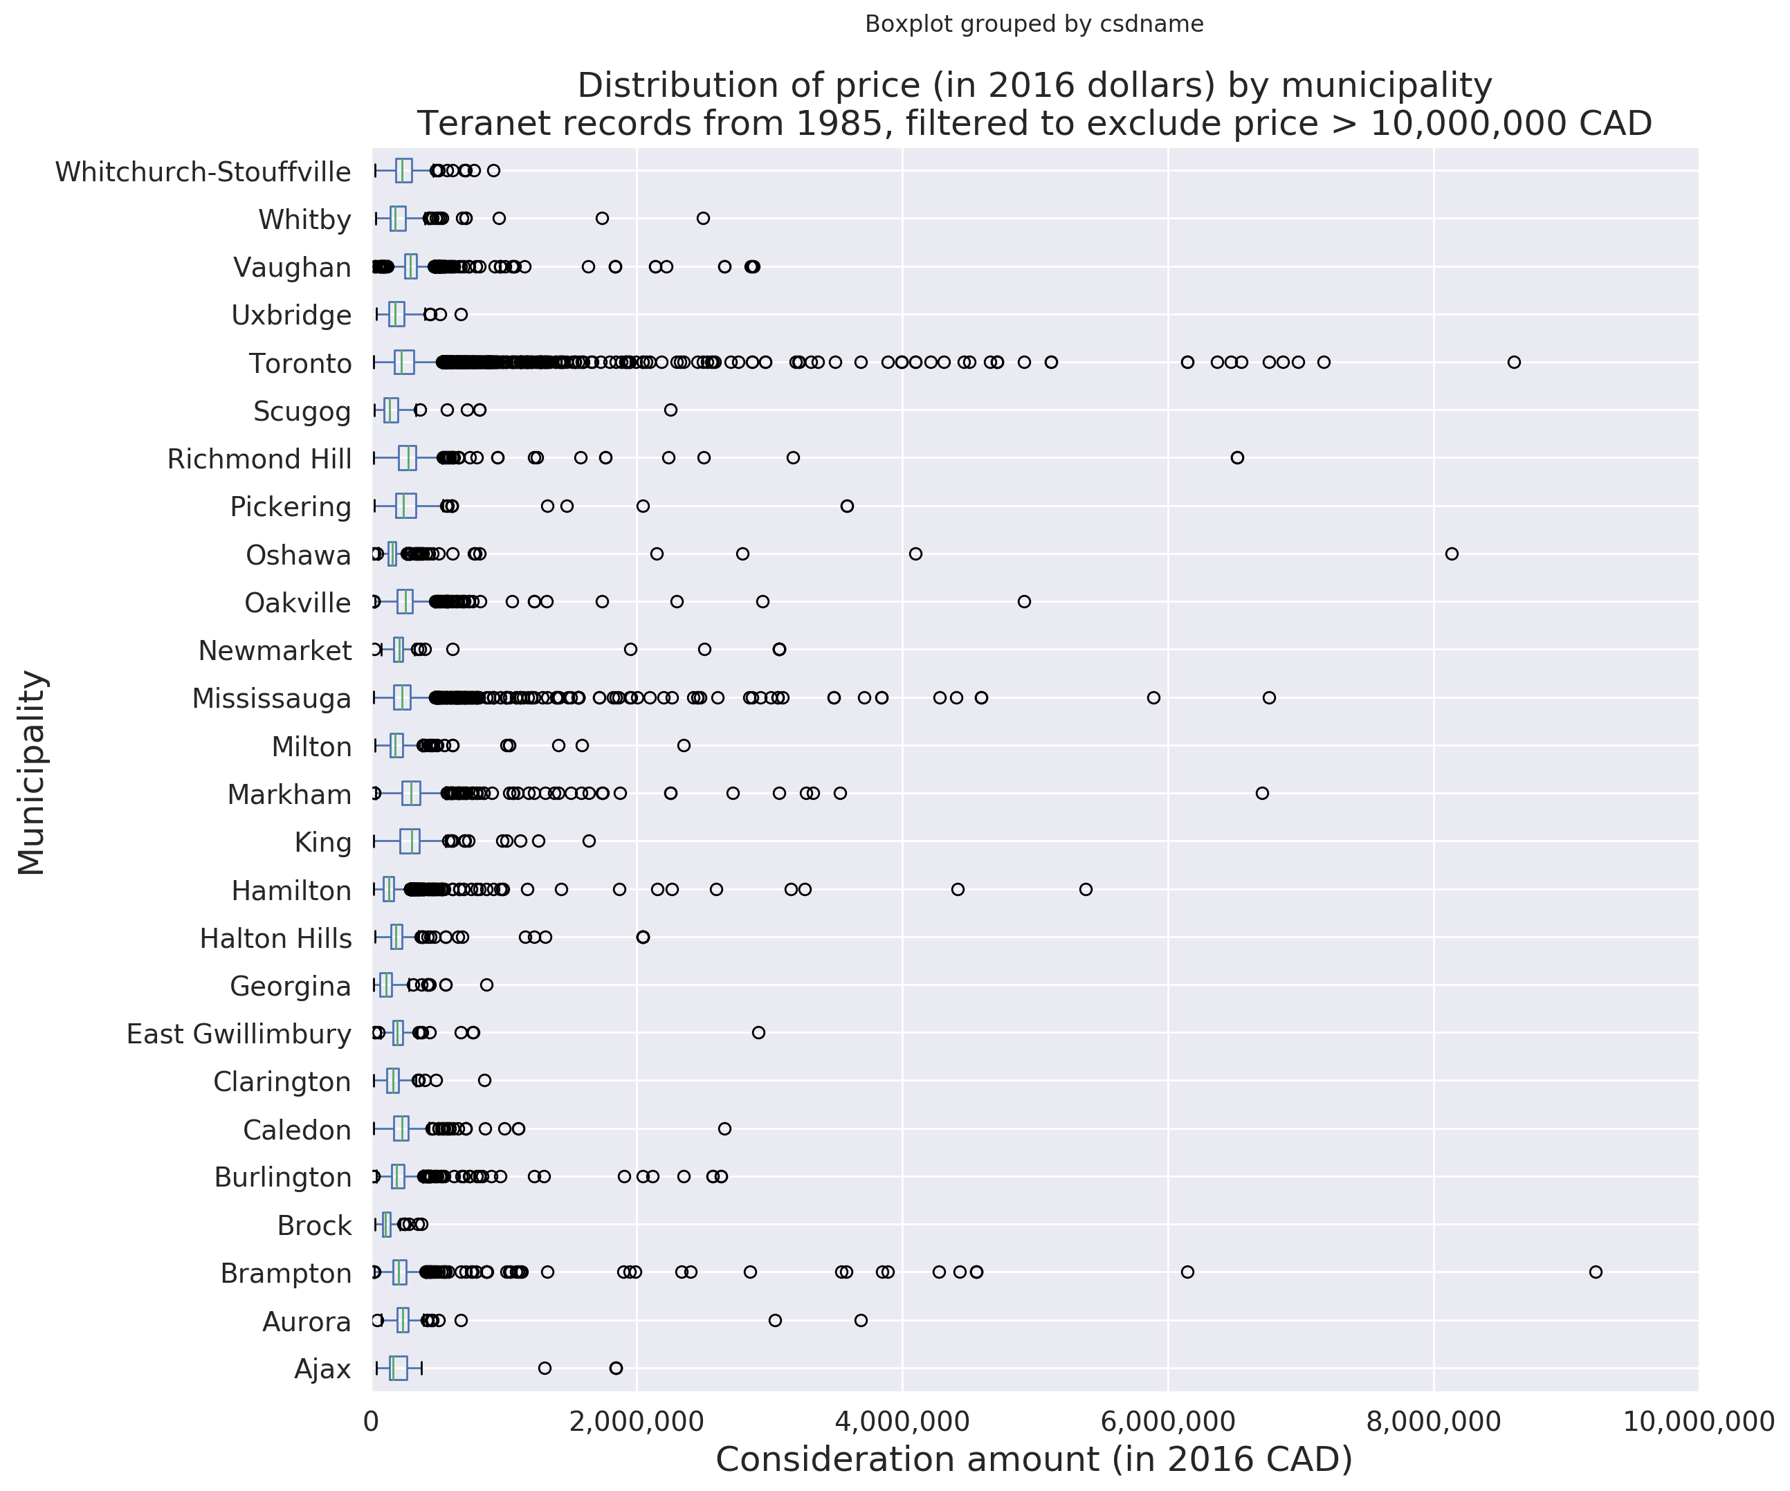

Slide 11
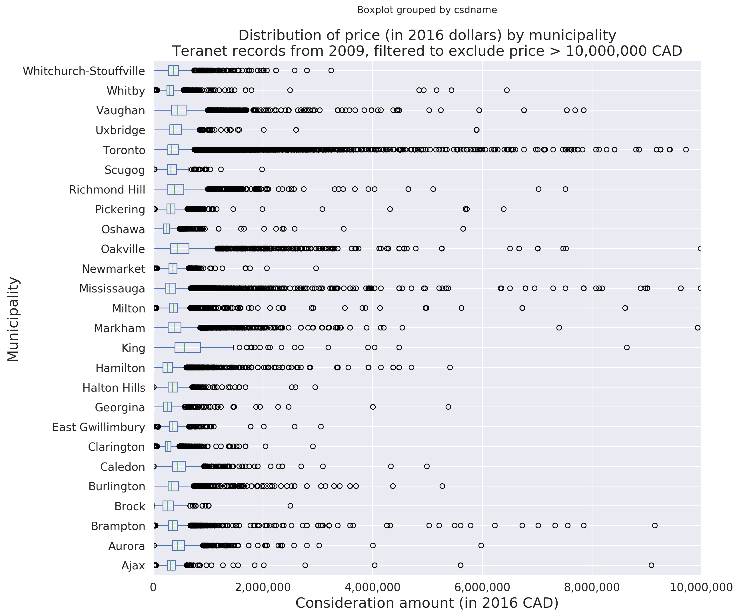

Slide 12
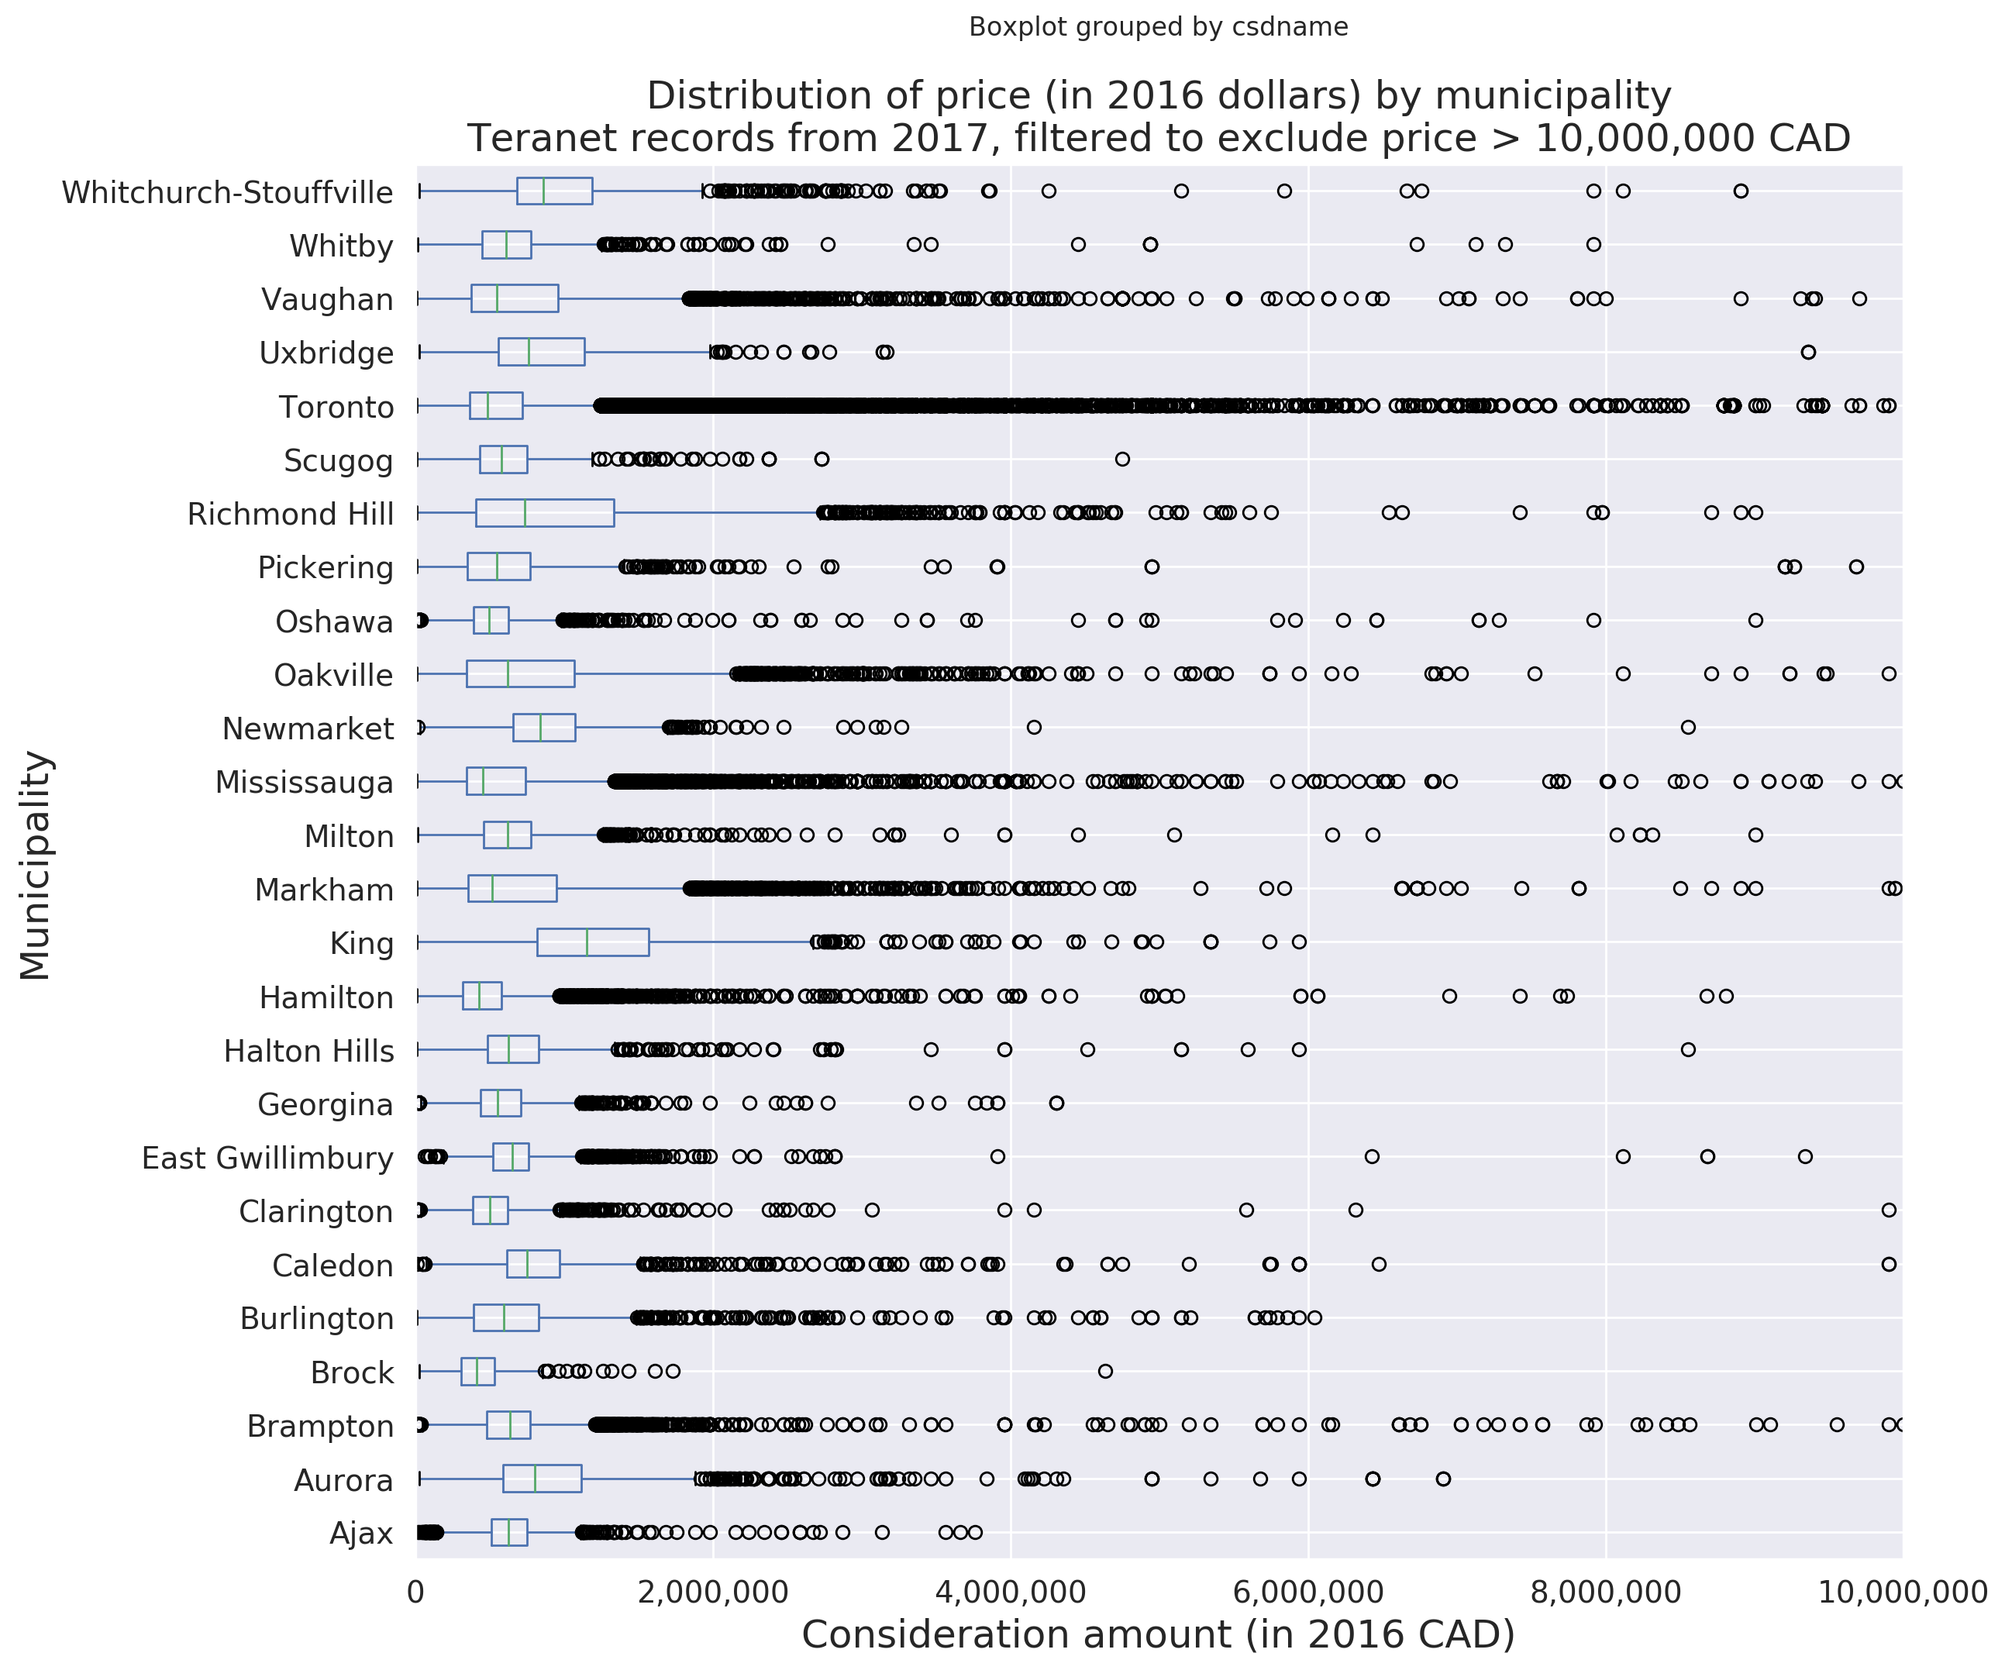

Slide 13
Section 1.3:
Boxplots of price
by detailed land use

Slide 14
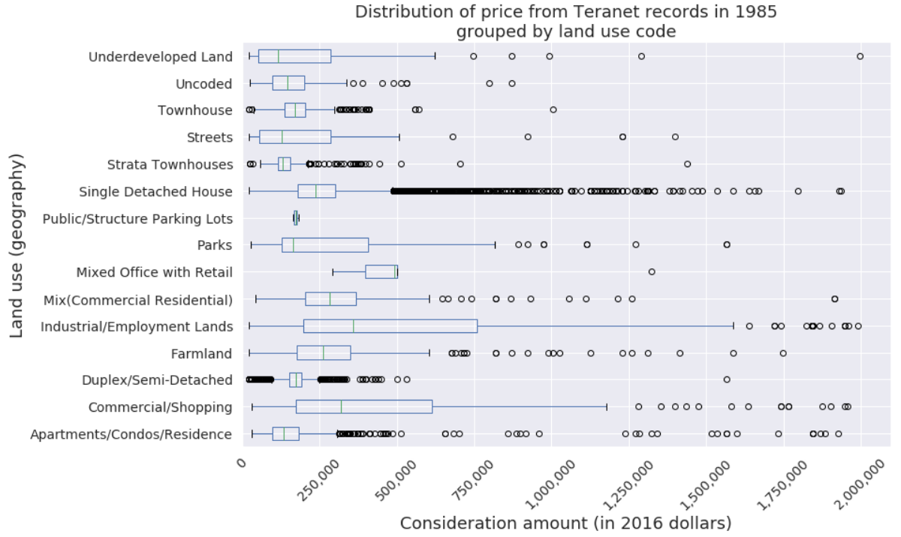

Slide 15
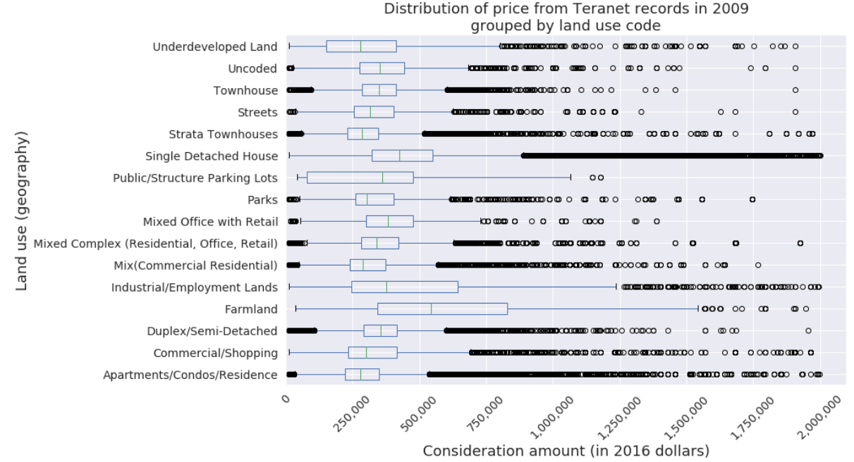

Slide 16
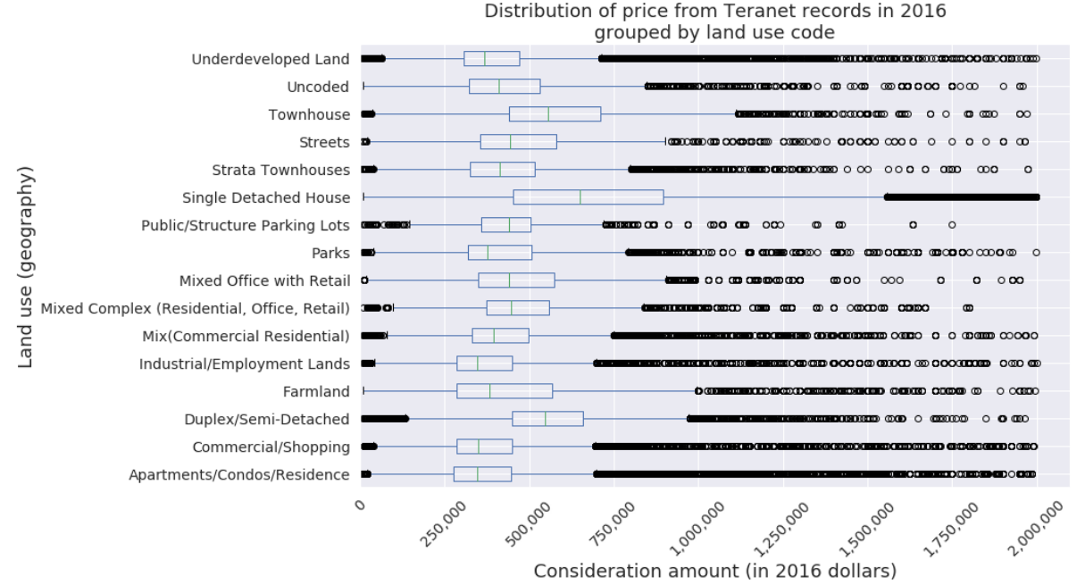

Slide 17
Section 2:
Large counts of records
by street name

Slide 18
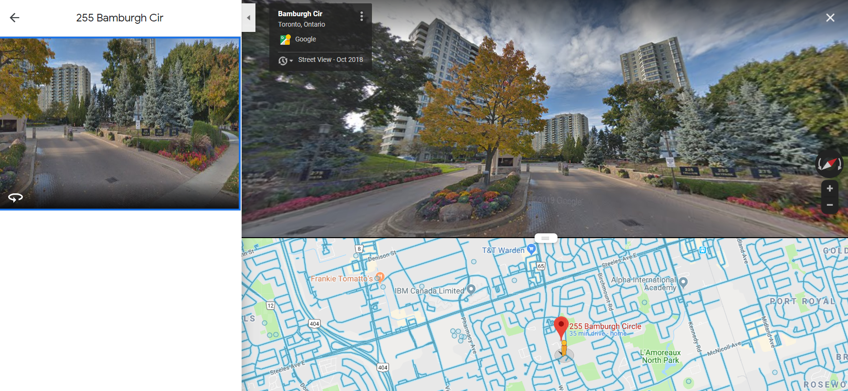
2.1: Bamburgh Cir, Scarborough

Slide 19
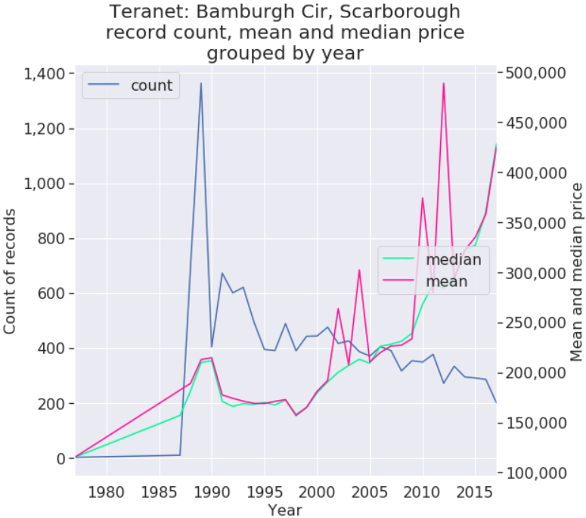
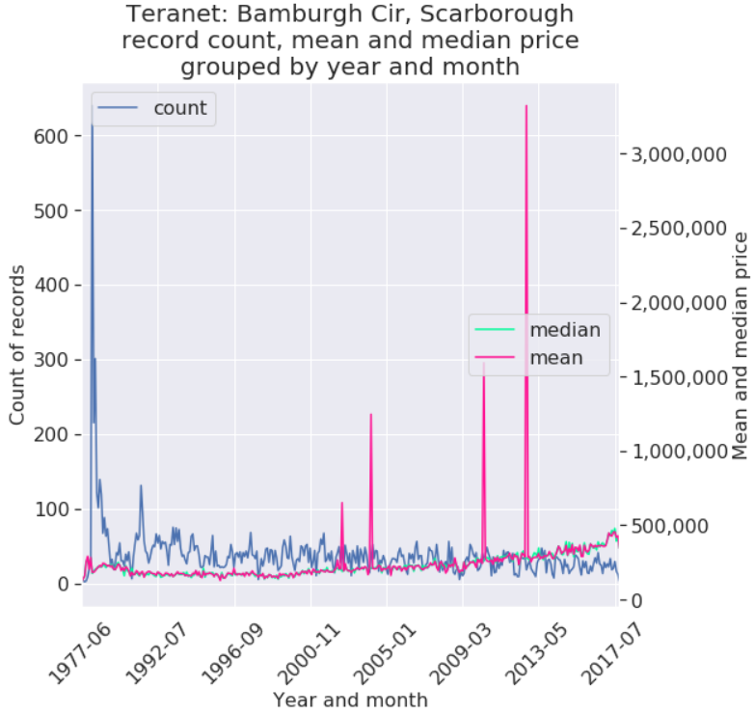
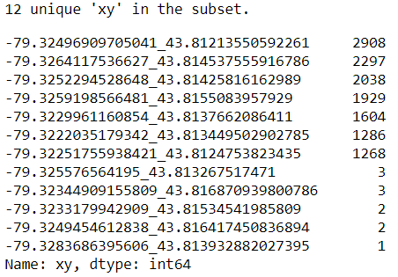
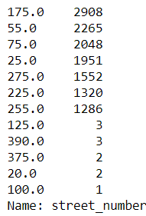
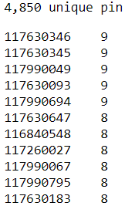
2.1: Bamburgh circle, Scarborough
Teranet record count
By street address:
By xy:
By pin:

Slide 20
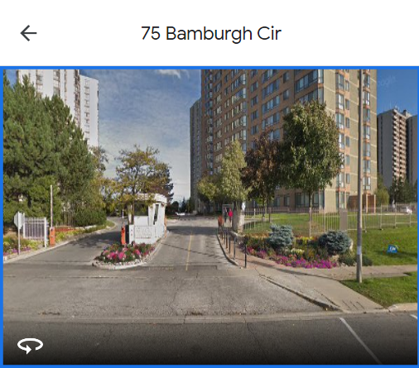
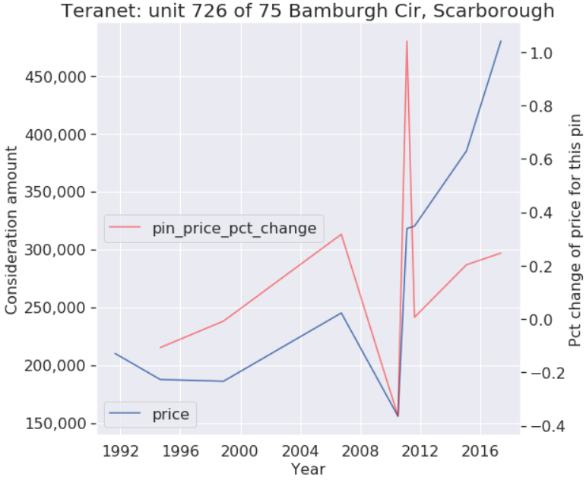
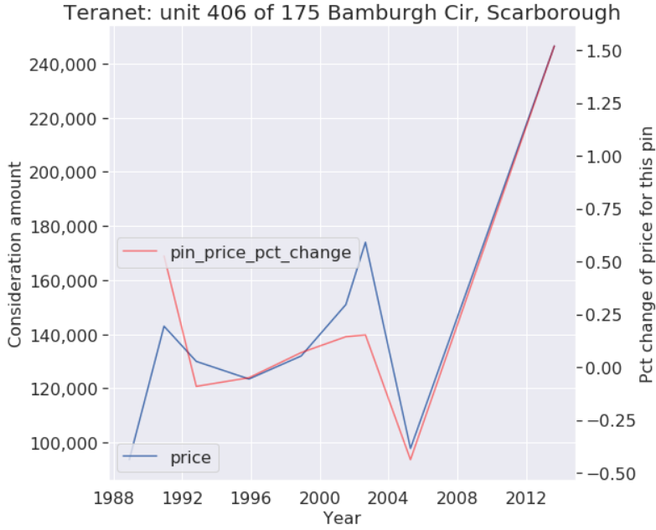
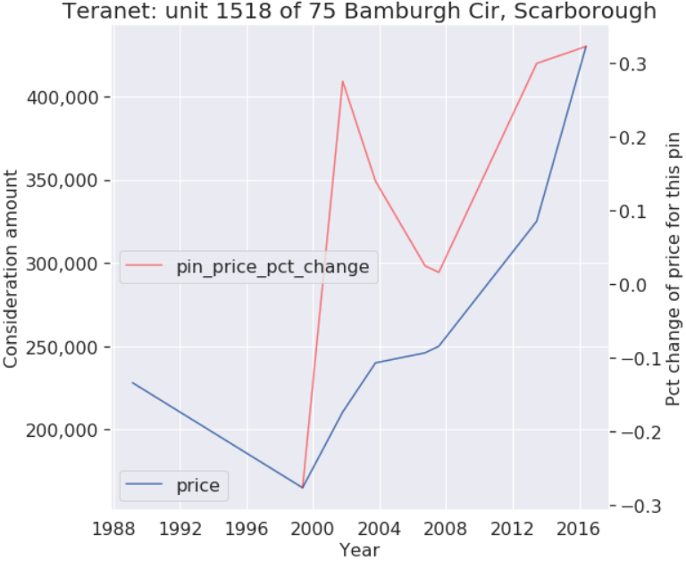
75 Bamburgh Cir, Scarborough individual unit sales

Slide 21
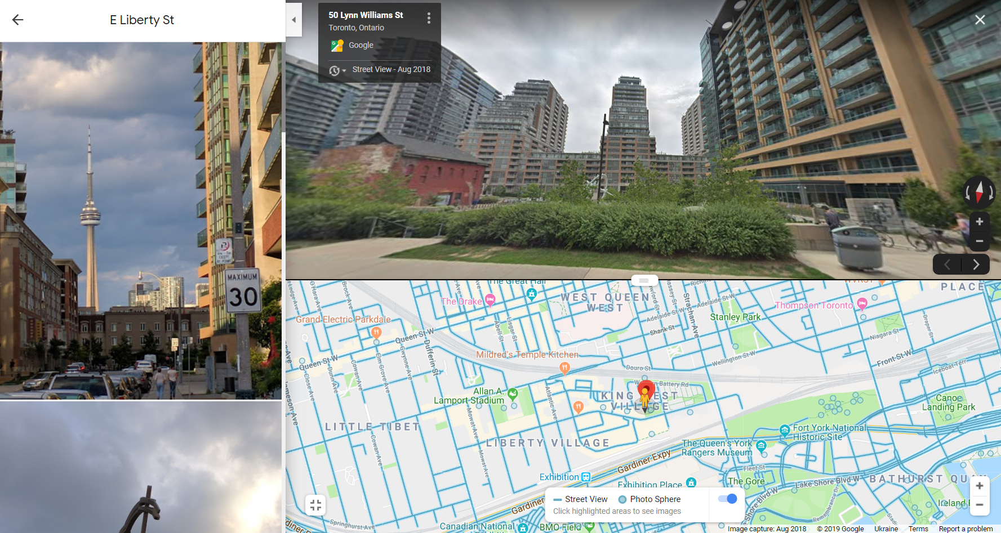
2.2: East Liberty St, Toronto

Slide 22
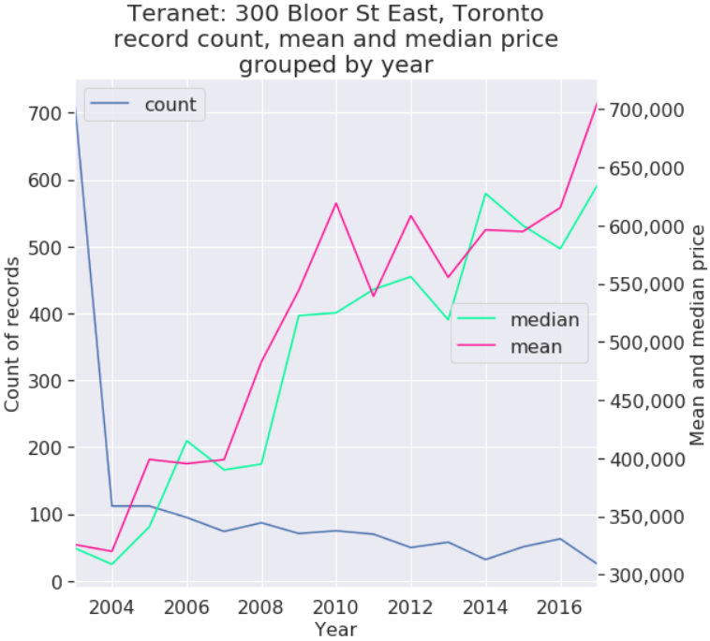
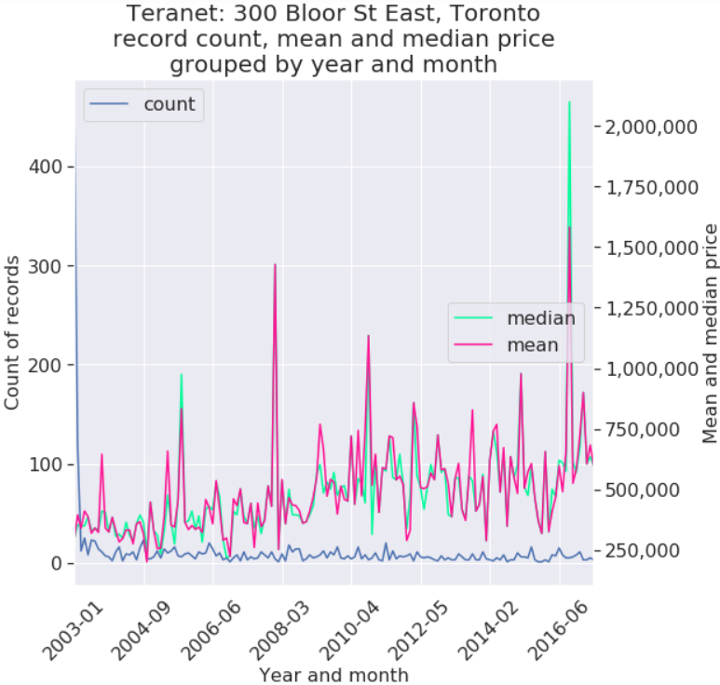
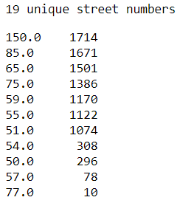
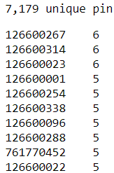
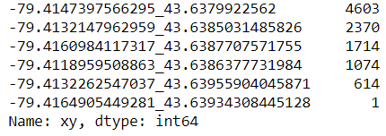
2.2: East Liberty St, Toronto
Teranet record count
By xy:
By street address:
By pin:

Slide 23
Section 3:
Large counts of records
by individual address

Slide 24
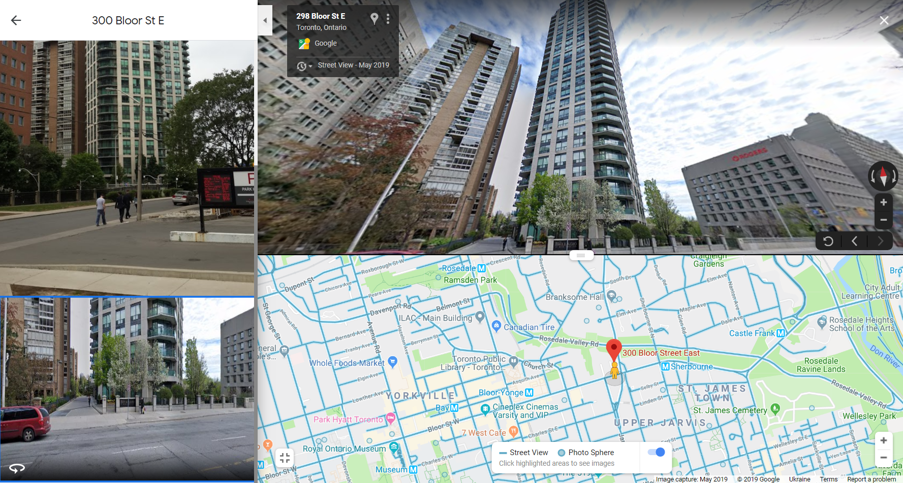
3.1: 300 Bloor St East, Toronto

Slide 25
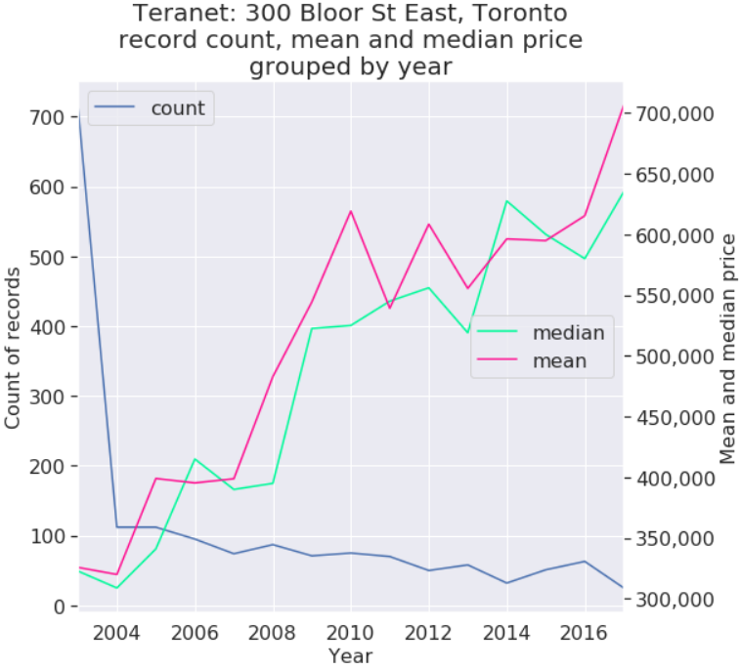
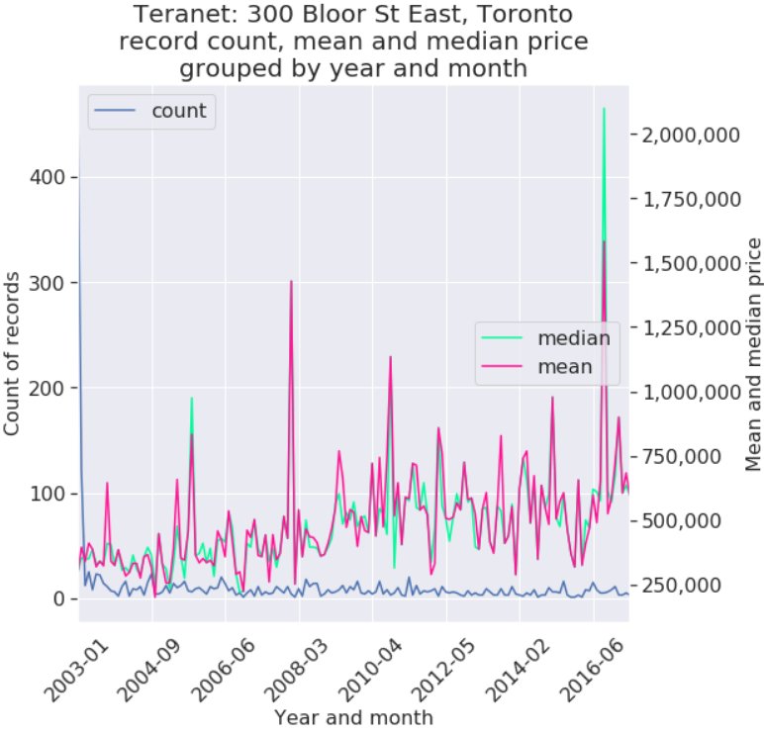
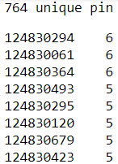
3.1: 300 Bloor St East, Toronto
Teranet record count
By pin:
By street address:
By xy:

Slide 26
Section 4:
Maps

Slide 27
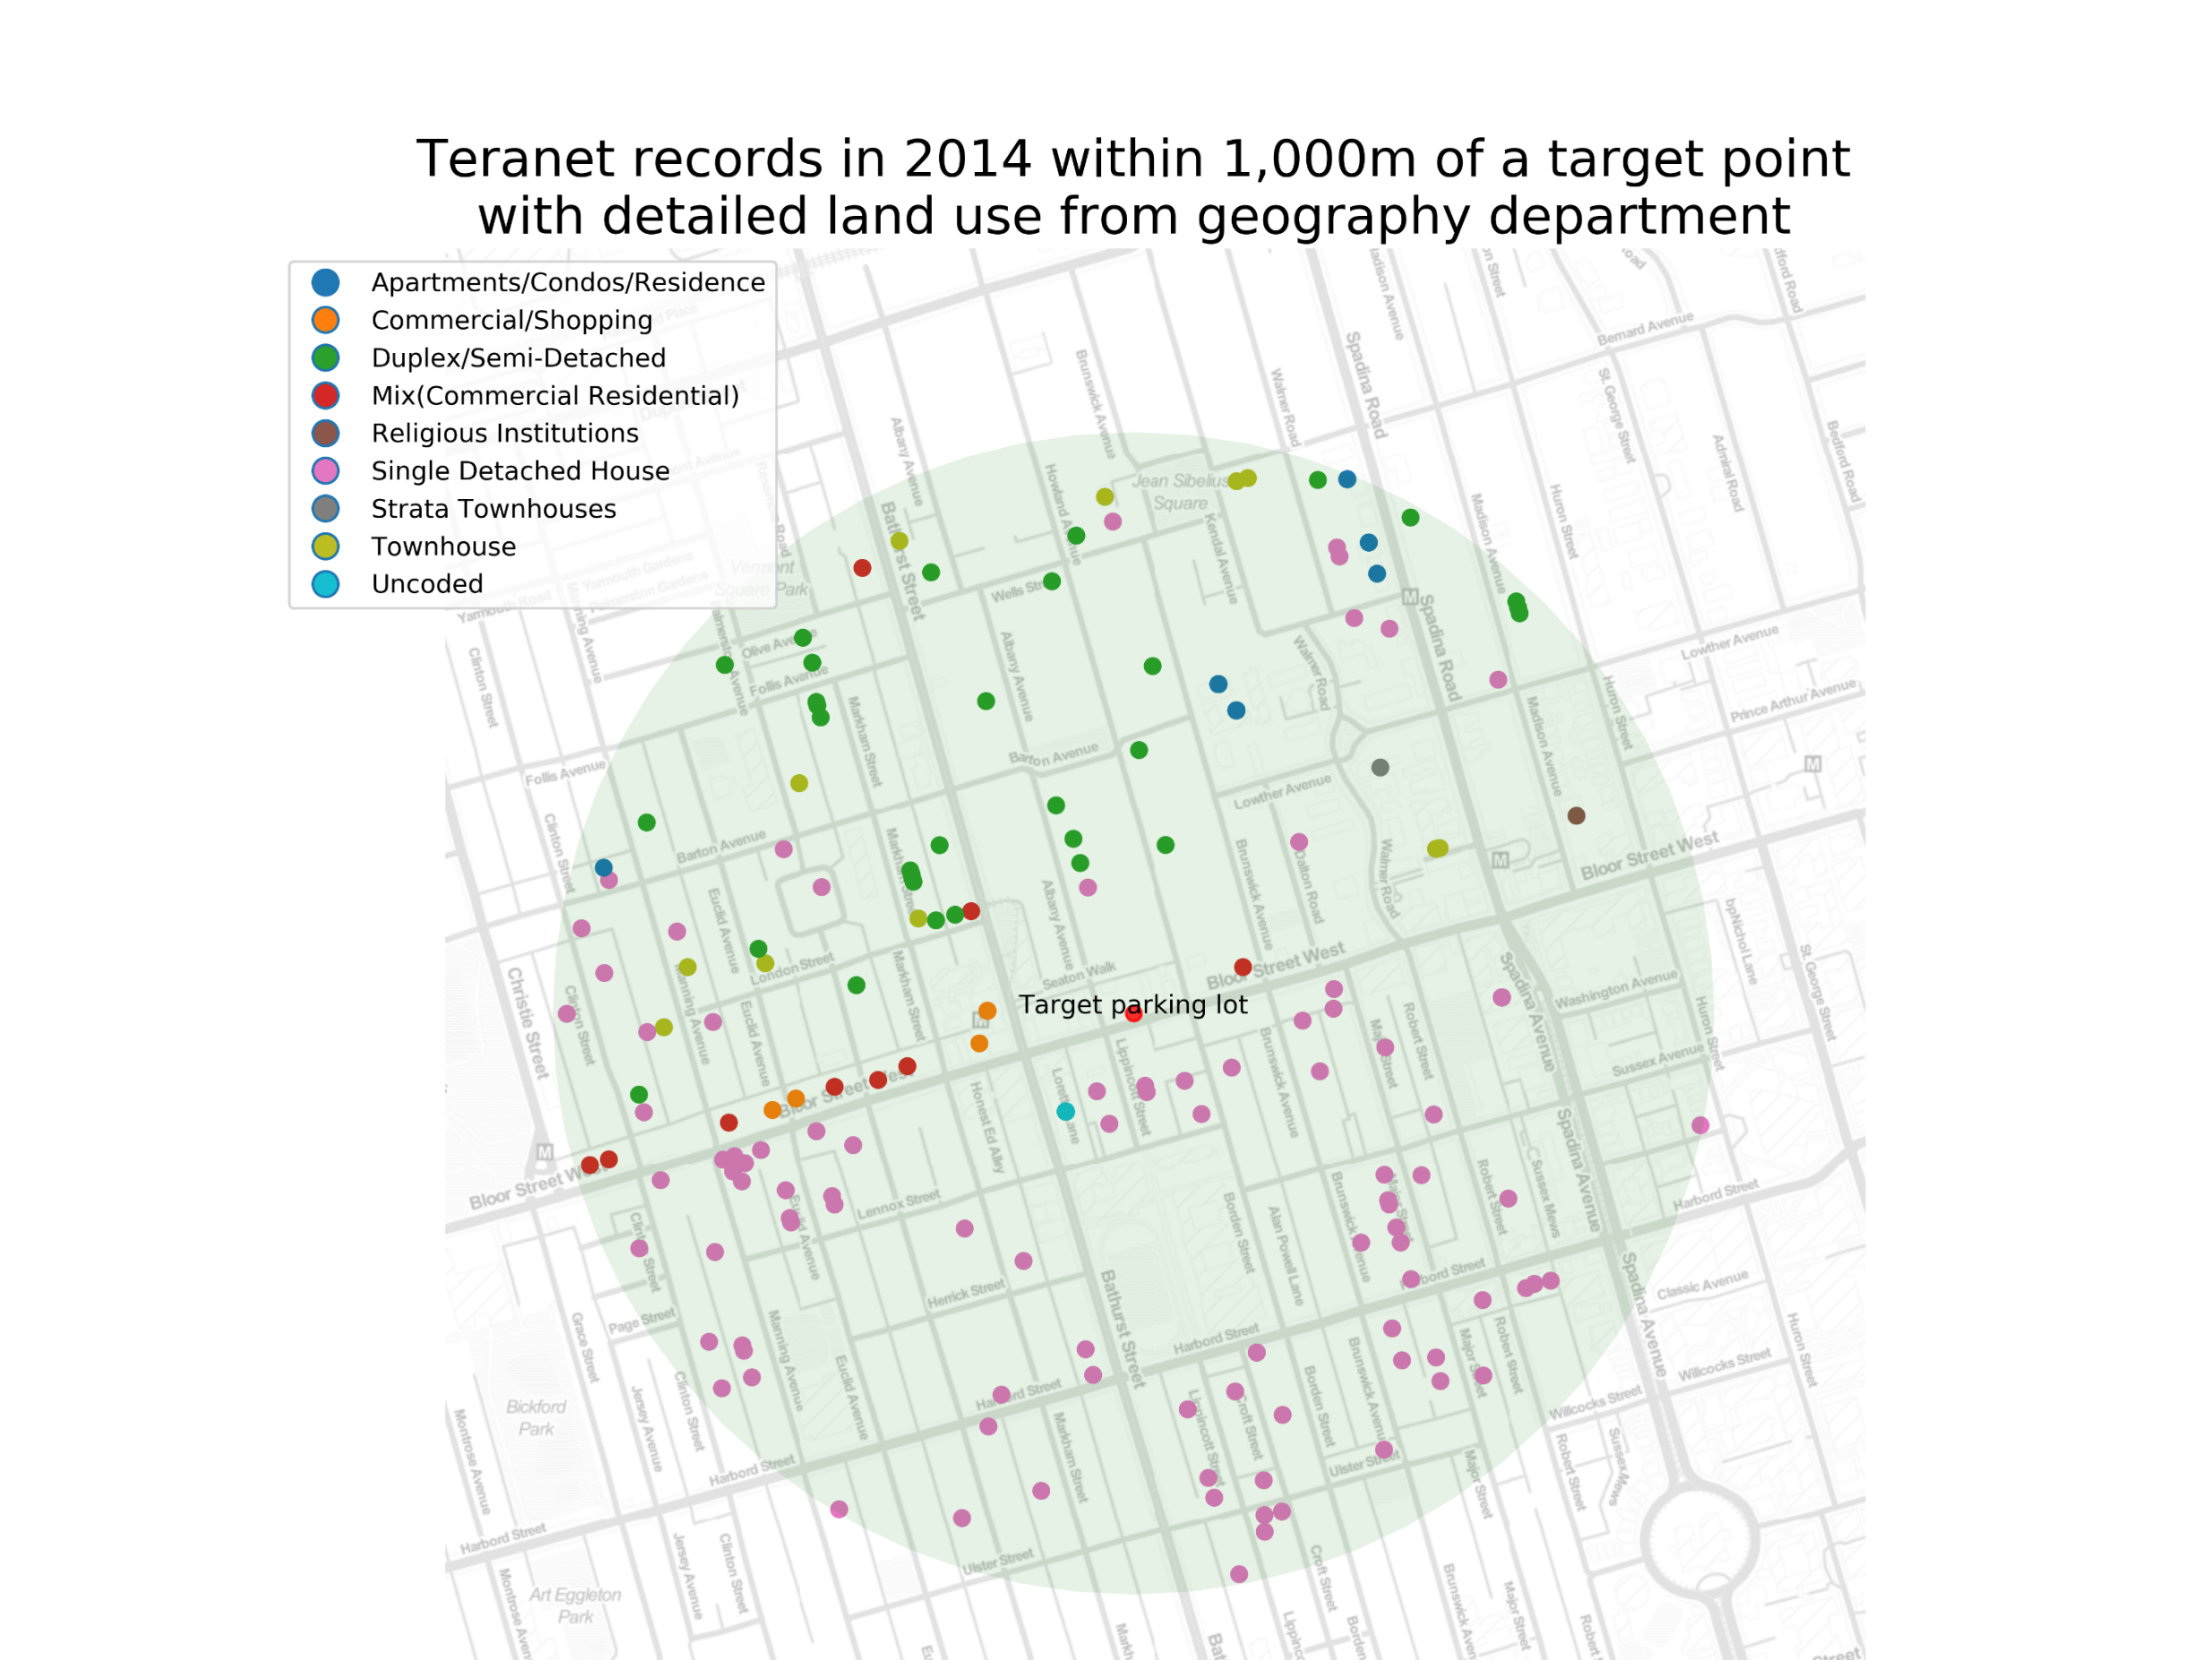
4.1 Teranet records within 1’000m of a point

Slide 28
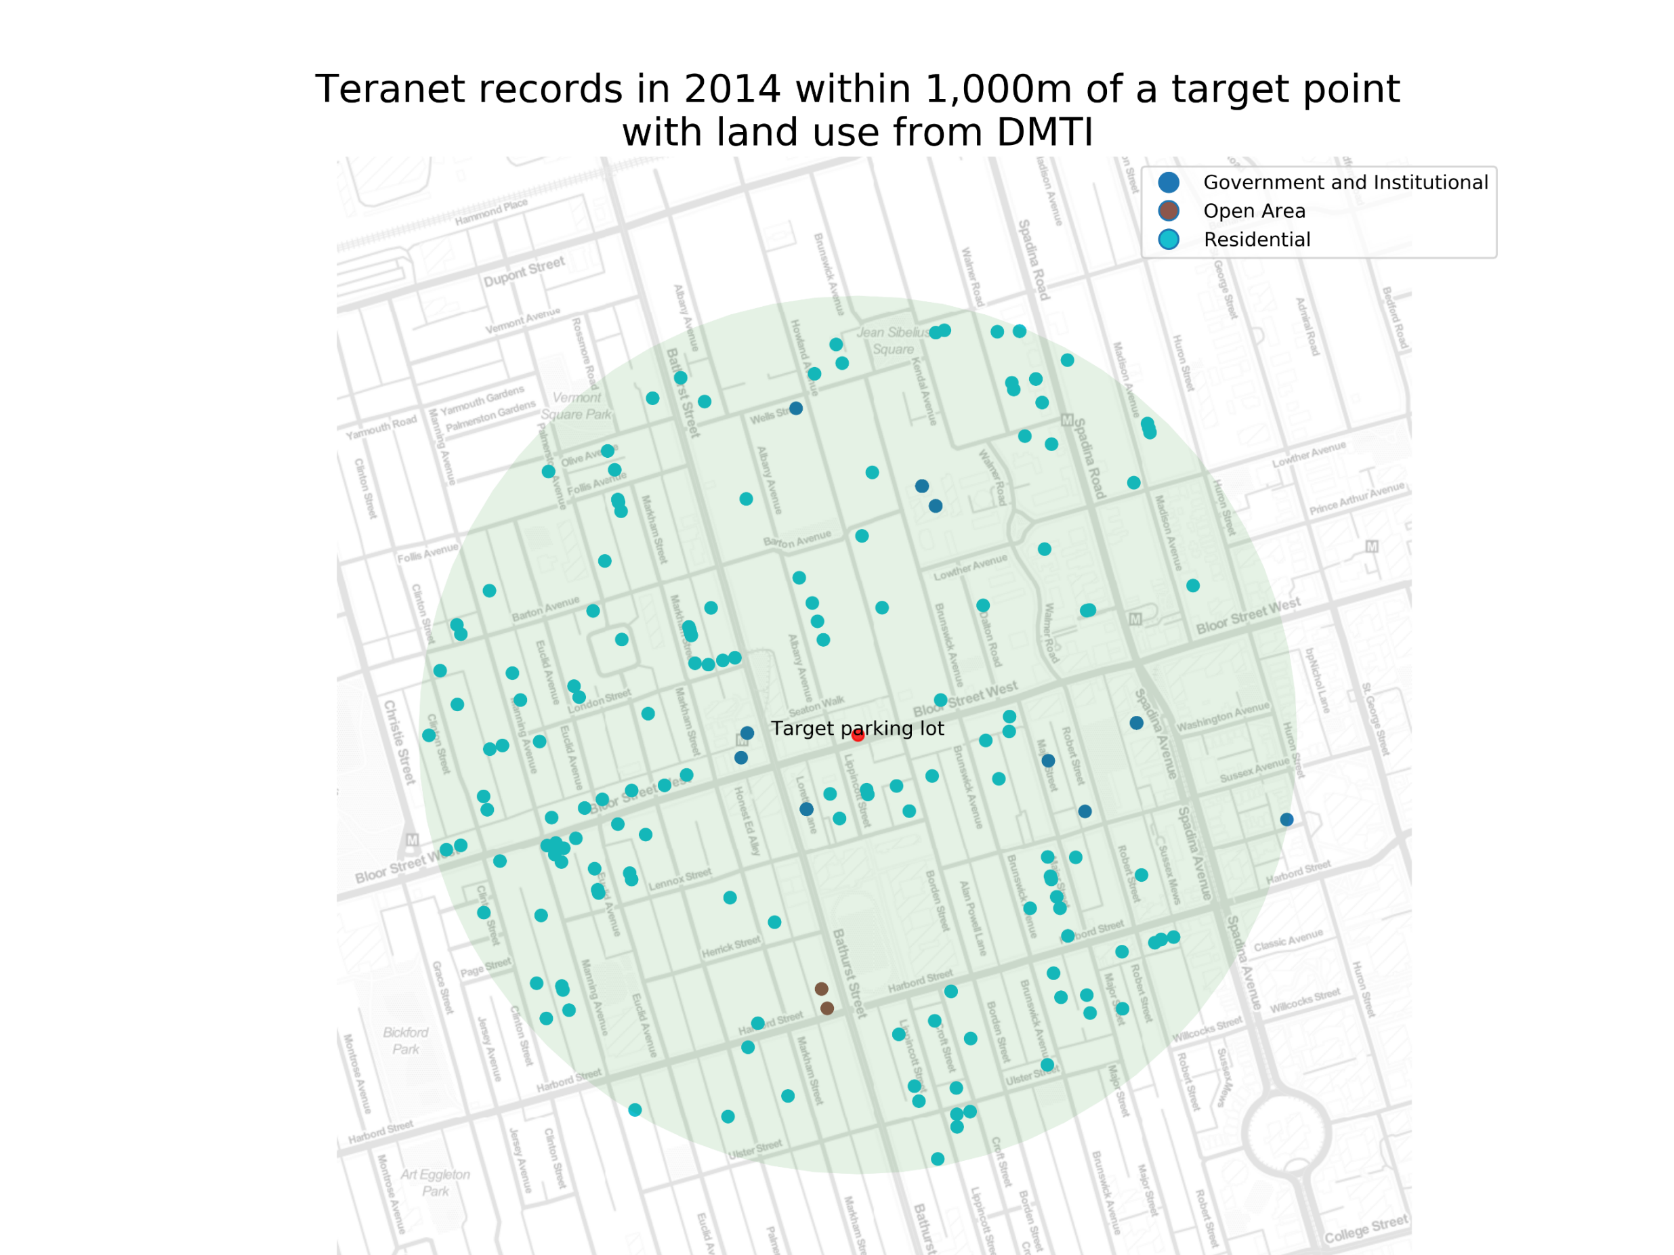
4.1 Teranet records within 1’000m of a point

Slide 29
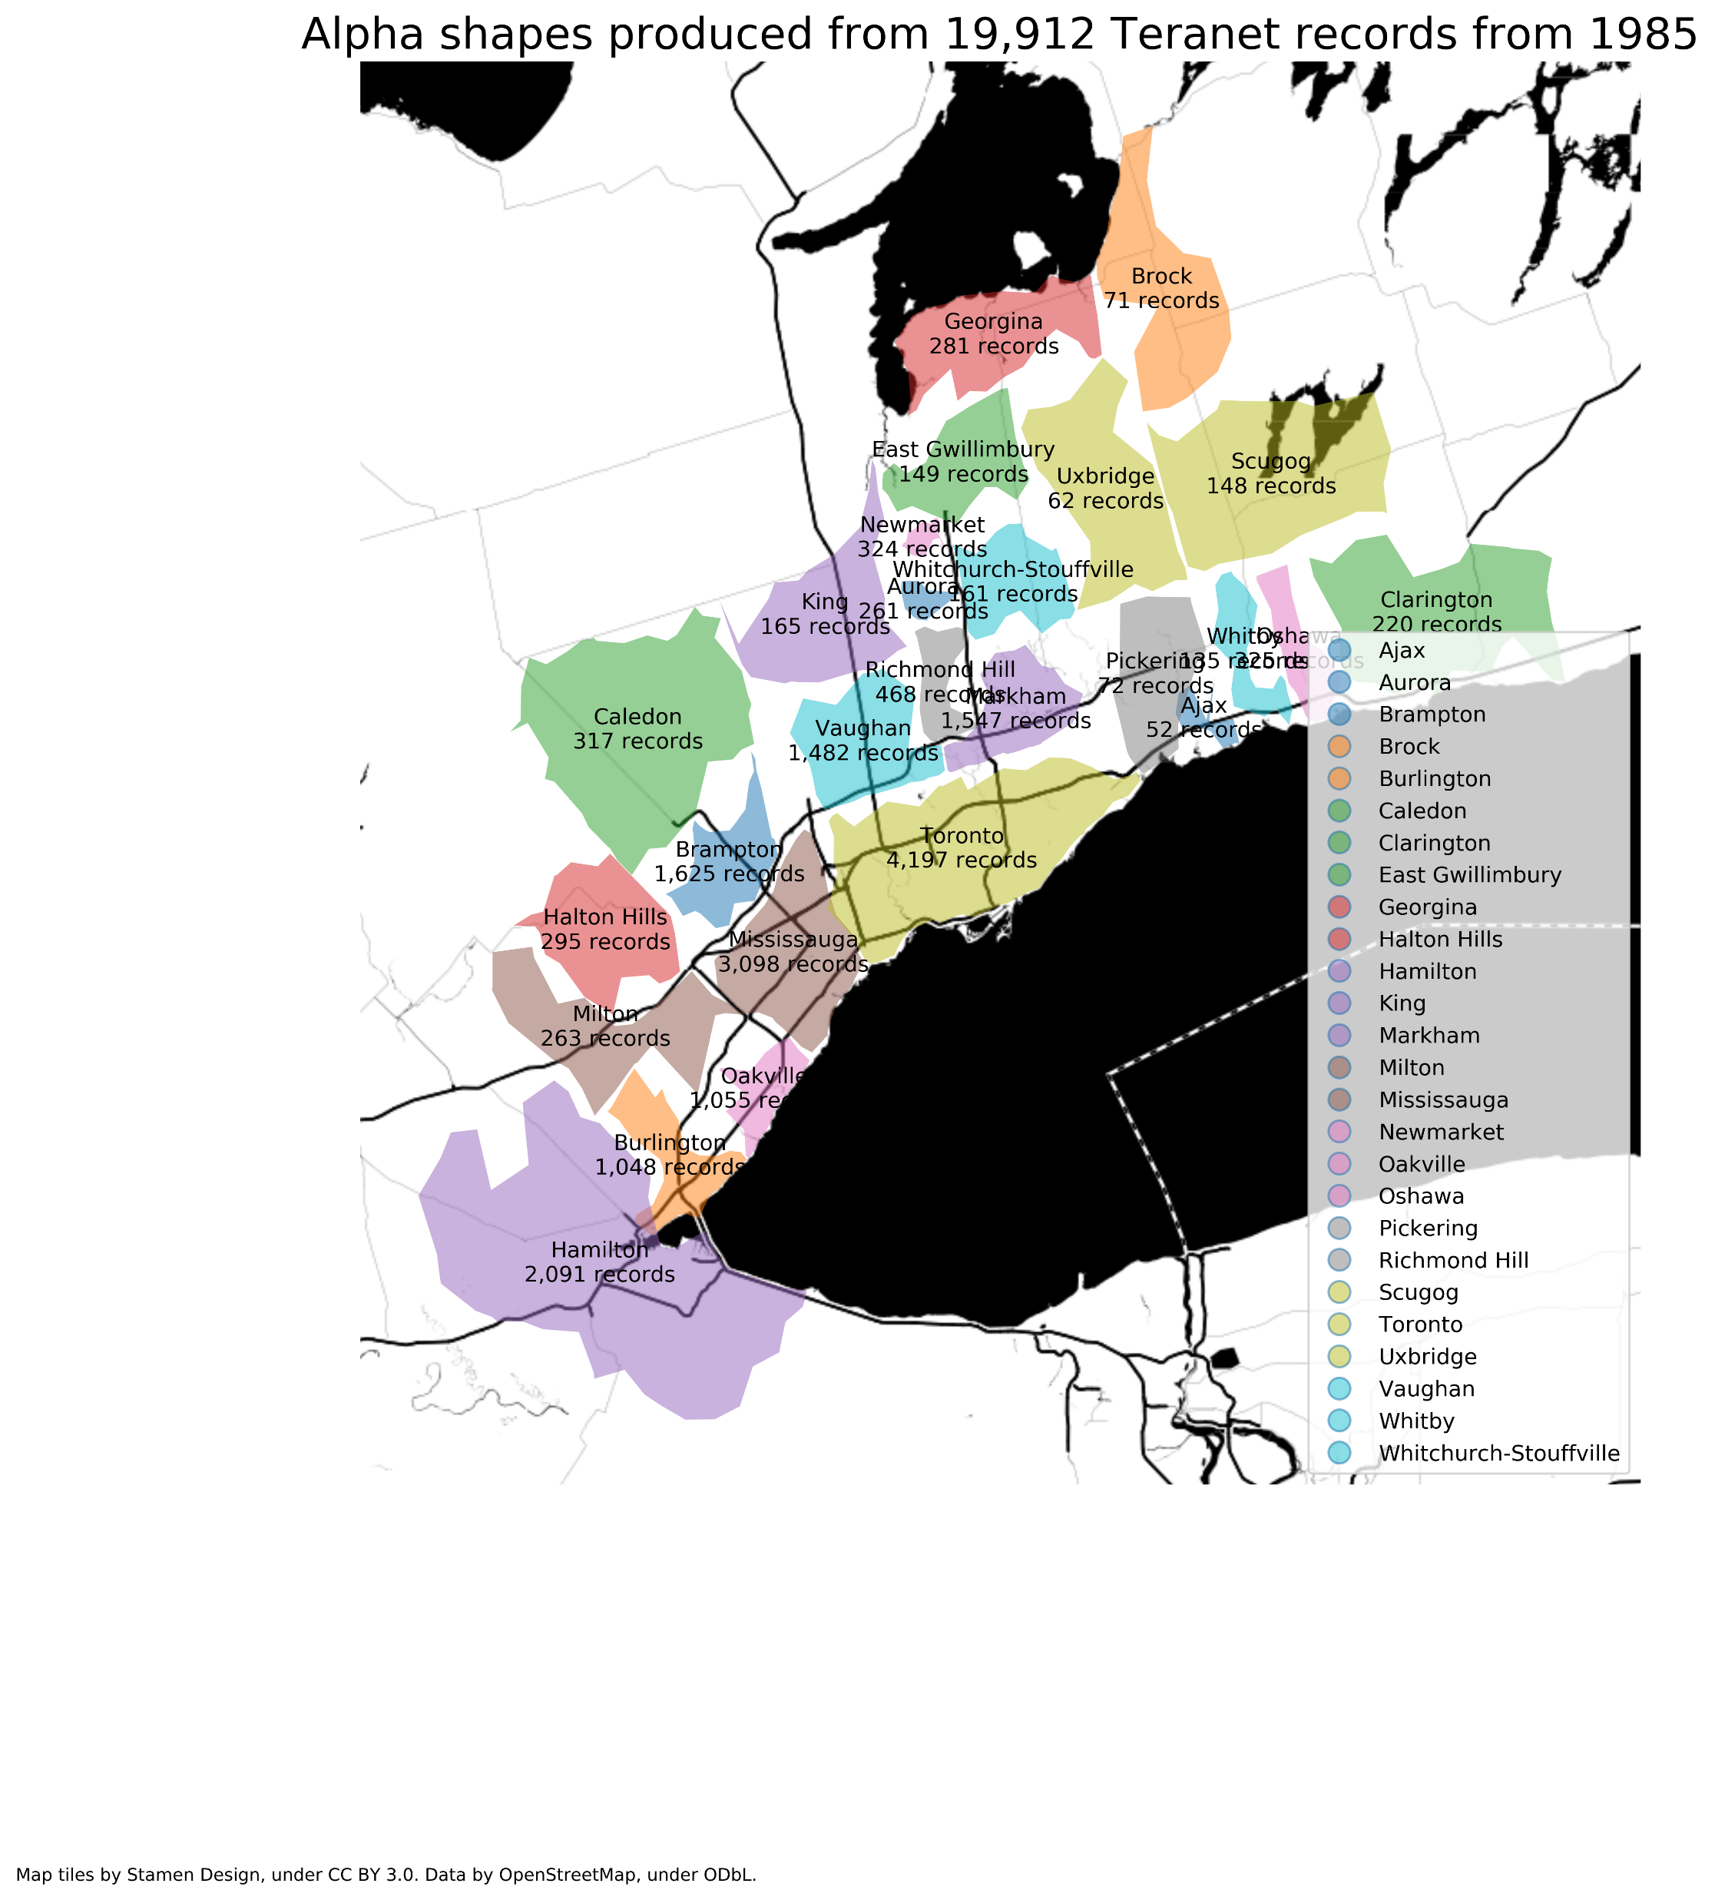
4.2 Alpha shapes of GTHA municipalities produced from Teranet records by year

Slide 30
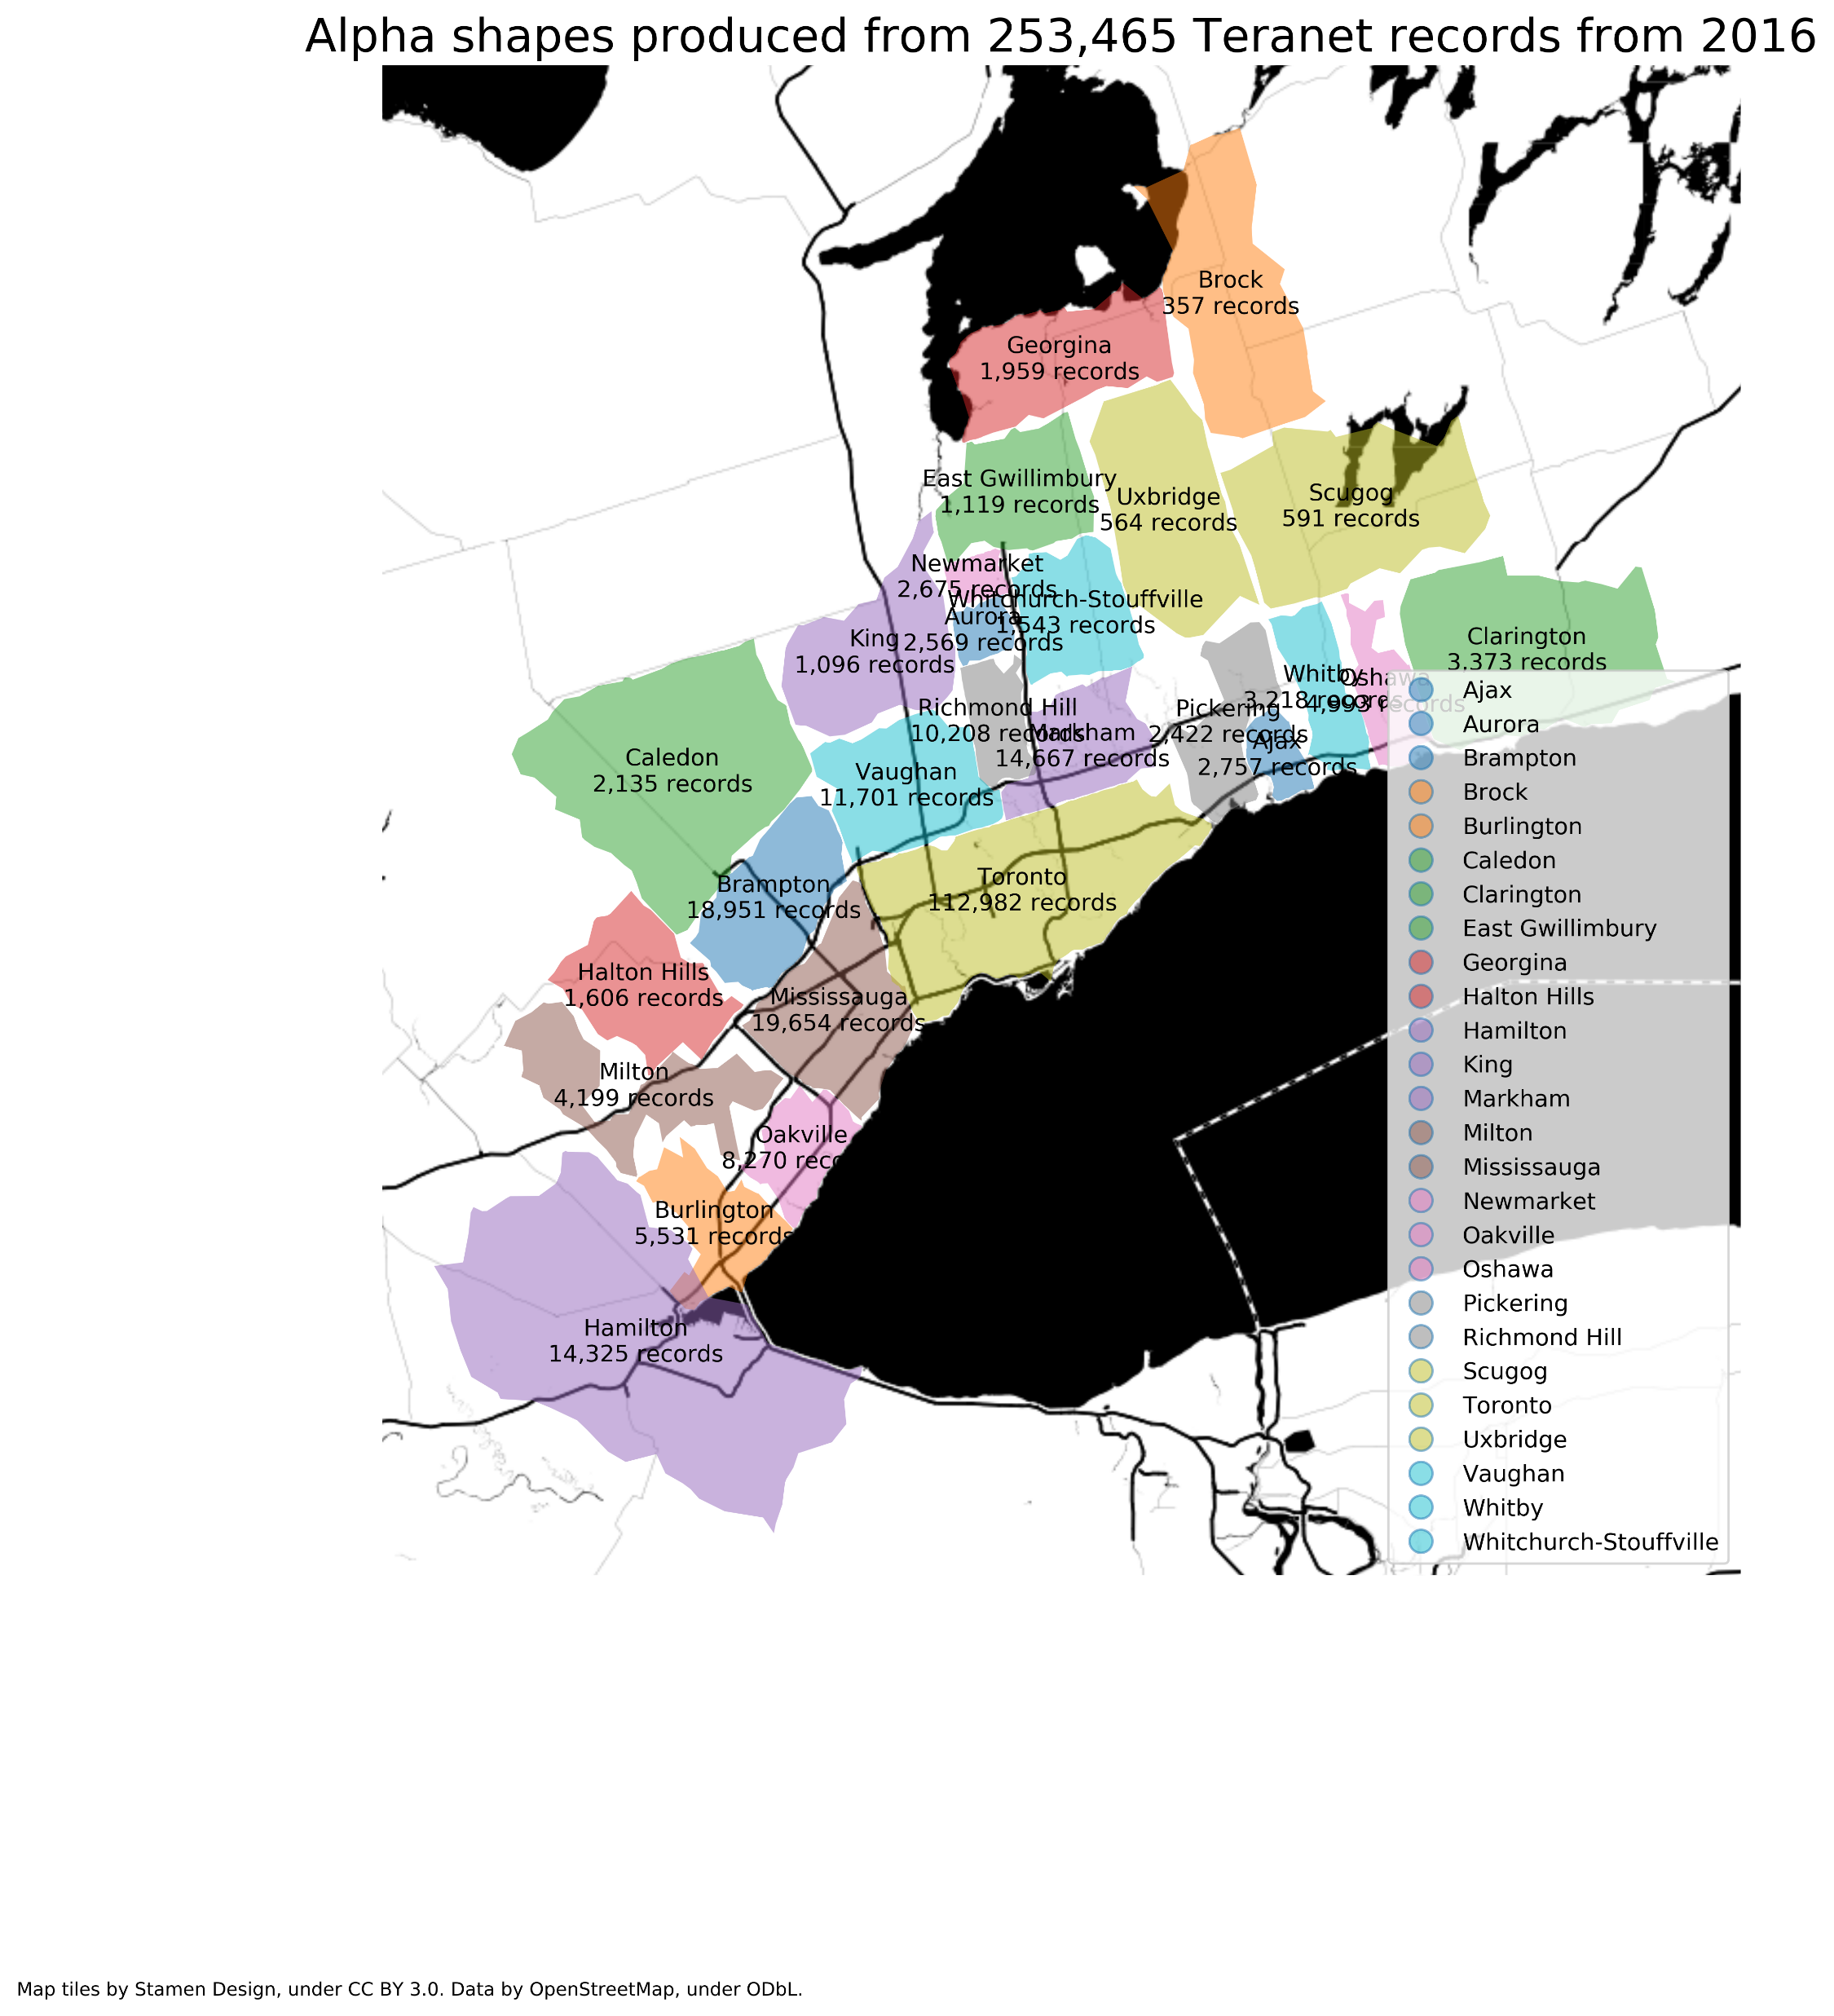
4.2 Alpha shapes of GTHA municipalities produced from Teranet records by year

Slide 31
Thesis chapters
Introduction
Background
complexity and “wicked” planning problems
land use and transportation
Land registration in Ontario
Challenges of working with Teranet data
Data sources, spatial, and temporal relationships
Data preparation
Database design
EDA
Conclusion

